Slide 1


Object Oriented Programing
Lecture #0
Notes:
1

Slide 2

EDU Revolution: Be the Change
New Year
New Beginning
New Excitement

Slide 3
Happy New Year Welcome to the New LPU
Learning by doing,
Application-based concept elaboration,
Learning beyond classrooms,
Activity-based assessments and project driven learning
Less Ppts and more interactive Classroom teaching
Experiential learning and Many More Initiatives

Slide 4
Happy New Year New Year, New Beginning, New Excitement Welcome to the New LPU
Simulation Based Lectures
Speaking Assessments
Case study-based Assignments
Less Ppts and more interactive Classroom teaching
Segmented Labs
Experiential learning and Many More Initiatives

Slide 5
What's New
Good Bye to old fashioned teaching and evaluation and let’s embrace the new paradigm Edu-Revolution: - Be the Change
Register to avail Privileges and benefits for the following Initiatives
A. Course Equivalence and Attendance Relaxation
B. Grade Revision and Overall Welfare (GROW)
C. 10 % Attendance waiver for students in Pre-final/Final year of the programme
D. Continuous Assessment Reduction Through Experience (CARE)
E. Students in active decision-making through Student Committees

Slide 6
Course Equivalence and Attendance Relaxation
Recognition of Prior Learning (RPL)
NPTEL Course/MOOCs/Certifications
Pursuing Project
Any other: In addition to above, the students may also suggest any additional aspect with regard to which the student is seeking course equivalence and attendance relaxation in the upcoming term

Slide 7
Recognition of Prior Learning (RPL)
Inform students about the concept of recognition of prior learning for basic elementary courses such as English, Mathematics, Analytical skills, Soft skills

Slide 8
NPTEL Course/MOOCs/Certifications
Enlist the MOOCs/Certifications applicable for the course
Encourage students to register for NPTEL/MOOCs/Certifications
Discuss the benefits associated with these courses (course equivalence and attendance relaxation)

Slide 9
Projects
Enlist short live projects that can be undertaken by the students
Guide students about the outcomes of the projects like Patent/Copyright/Publication/Industry funding/ Government sponsorship (like ATAL Innovation Mission)

Slide 10
Grade Revision and Overall Welfare (GROW)
Enlist applicable national/international competitions/hackathons of repute and guide the students about opportunity to improve their existing grades through their involvement

Slide 11
Attendance Relaxation (only for Pre-final/Final year of the programme)
Students with a CGPA of 8 or higher can apply for an attendance relaxation in their pre-final/final year. Eligible students will be granted a 10% attendance relaxation to support their career development for pursuing the following aspirations like:
Preparation of Competitive Exam
Preparation of Technical Competition
Freelancing Activity/Entrepreneurship/ Revenue Generation
Industry/ Field Project
Consultancy Project

Slide 12
Continuous Assessment Reduction through Experience (CARE)
Brief introduction of the continuous assessment of the course.
Students must be made aware of the CA modification that can be applicable to the course.
Identify innovative CA models like real life problems, surveys live projects etc.
State examples of real-life problems that can be taken up for the course.

Slide 13
Students in active decision-making through Student Committees
Students will be actively involved in decision-making related to academic and learning procedures applicable to them, by becoming a member of various committees as listed below:
Student Academic and Project Review Committee
Student Career Committee
Student entrepreneurship and Media Committee

Slide 14
Interfaces and Contact Information
UMS link to apply for EDU Revolution initiatives:
UMS Navigation --- LMS → EDU Revolution: BE THE CHANGE
In case of any query in this regard the student can approach for resolution through RMS at the following path:
UMS Navigation--- Relationship management system → EDU Revolution: BE THE CHANGE
OR get your queries resolved through the Helpline Number: 01824-520150.

Slide 15
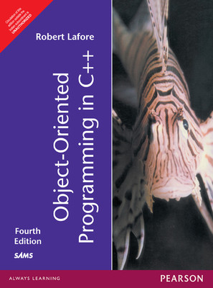
Course details
Text Book
OBJECT ORIENTED PROGRAMMING IN C++
by Robert Lafore, PEARSON
Notes:
15

Slide 16
Vision and Mission of University
Vision: To be a premier academic institution, recognized internationally for its contribution to industry and society through excellence in teaching, learning, research, internationalization, entrepreneurship and leadership.
Mission:
To transform education through academic rigour, practical orientation and outcome based teaching.
To develop and implement a relationship of cooperation between industry and academia.
To undertake impactful research addressing local, national and global challenges.
To prepare graduates to be lifelong learners with strong analytical and leadership skills.
To develop global professionals and entrepreneurs with innovative spirit, tolerance and desire to make a difference to the society.

Slide 17
Vision and Mission of SEEE
Vision: To become one of the leading Schools globally in Electronics and Electrical Engineering recognized for its academics and innovations by nurturing professionals, researchers and entrepreneurs for sustainable growth of industry and society.
Mission:
To provide a learning-based environment on technical concepts applied to real-life situations with measurable outcomes.
To establish connections with the industry for curriculum design, and creating internship cum career opportunities.
To address societal issues related to regional, national and global challenges through meaningful research.
To inspire graduates for pursuing lifelong learning in professional careers.
To develop leadership potential in ethically competent entrepreneurs.

Slide 18
Program Outcomes as specific to the particular course
PO-1:Engineering knowledge::Apply the knowledge of mathematics, science, engineering fundamentals, and an engineering specialization to the solution of complex engineering problems.
PO-2: Problem analysis::Identify, formulate, research literature, and analyze complex engineering problems reaching substantiated conclusions using first principles of mathematics, natural sciences, and engineering sciences.
PO-3:Design/development of solutions::Design solutions for complex engineering problems and design system components or processes that meet the specified needs with appropriate consideration for the public health and safety, and the cultural, societal, and environmental considerations.
PO-4:Conduct investigations of complex problems::Use research-based knowledge and research methods including design of experiments, analysis and interpretation of data, and synthesis of the information to provide valid conclusions.
PO-5: Modern tool usage::Create, select, and apply appropriate techniques, resources, and modern engineering and IT tools including prediction and modeling to complex engineering activities with an understanding of the limitations
PO-8:Ethics::Apply ethical principles and commit to professional ethics and responsibilities and norms of the engineering practice.
PO-9:Individual and team work::Function effectively as an individual, and as a member or leader in diverse teams, and in multidisciplinary settings.
PO-10: Communication: Communicate effectively on complex engineering activities with the engineering
PO-11: community and with society at large, such as, being able to comprehend and write effective reports and design documentation, make effective presentations, and give and receive clear instructions.
PO-12: Life-long learning::Recognize the need for, and have the preparation and ability to engage in independent and life-long learning in the broadest context of technological change.

Slide 19
Course outcomes
CO1 :: identify basic programming constructs and use the newly acquired skills to solve extensive programming problems
CO2 :: discuss the mechanism of code reusability by creating own libraries of functions
CO3 :: validate the logic building and code formulation by designing code capable of passing various test cases
CO4 :: interpret the principles of the object-oriented model and apply it in the implementation in C ++ language
CO5 :: develop accurate, reliable and efficient software applications
CO6 :: apply the knowledge acquired to develop software applications

Slide 20
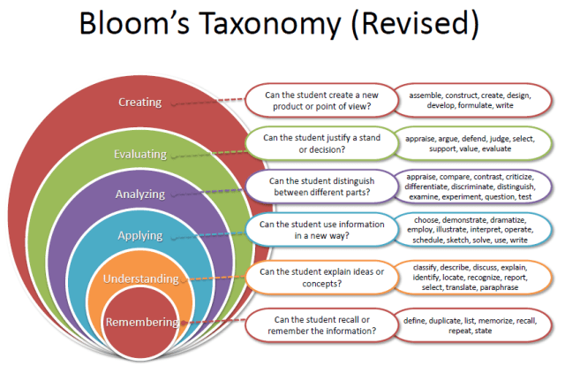
Revised Bloom’s Taxonomy
Notes:
20

Slide 21

COURSE
This course provides a pathway for the students to gain insights about the technical skills in the field of programming.
This course helps the students to apply their technical skills to become software developers.
Students could be able to streamline their career in programming and become industry-ready.
C++ is basic requirement for mist of the companies for placement drives.
Notes:
21

Slide 22
Execution strategy for courses
Role Play Activity: Student will play a role of object to discuss the OOP concept.
Debate Procedural vs Object-Oriented Programming: Divide the class into two groups. Each group argues for one paradigm using examples.
Github repository creation: Student will upload the implementation of code in the class.
Error-Handling Workshop: Students will understand the compile time errors and capable of handle input errors (e.g., invalid data)
Online 3rd Party Challenge: The student will assign test case-based problems on any online platform; the students have to solve it within the given time limit.
Notes:
22

Slide 23
INNOVATIVE PEDAGOGY
IT job profile screening
Placement drives level coding tasks
Hackerrank based problem solving
Live demonstration using compliers
Code Review
Analysis of existing object-oriented code
Notes:
23

Slide 24

Online Resourcses
MIT OpenCourseware / Stanford online
Udemy / Coursera
The homepage of Bjarne Stroustrup, the inventor of C++: http://www.research.att.com/~bs
A C++ online tutorial: http://www.cplusplus.com/doc/tutorial/
The C++ FAQ: http://www.parashift.com/c++-faq-lite
learncpp.com
and many, many more!

Slide 25
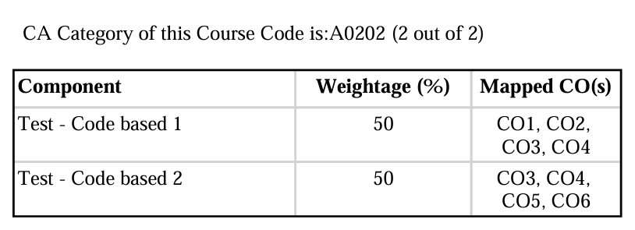
Evaluation strategy
CA1: Test - Code based 1 week:6
CA2: Test - Code based 2 week: 13
**Both CA are compulsory

Slide 26
Course Weightage
ATT: 5
CA: 30
MTT: 20
ETT: 45

Slide 27
The course contents
Unit I: Concepts and Basics of C++ Programming, Functions and Input/output Streams.
Unit II: Pointers, Reference Variables, Arrays and String Concepts
Unit III: Constructor, destructor and File Handling

Slide 28
Unit IV: Operator Overloading and Type Conversion, Inheritance and Aggregation.
Unit V : Dynamic Memory Management, Polymorphism
Unit VI: Exception Handling, Templates and Standard Template Library (STL)

Slide 29
Gamification of Learning
Level 1: C++ Explorer – Platform Overview and Basics
Level 2: Data Wizard – Working and manipulation of Data
Level 3: Logic Master – Mastering Conditions and Loops
Level 4: OOP Hero– Understanding Classes Objects
Level 5: Inheritance Champion
Level 6: Encapsulation Hero – Securing Data and Structure
Level 7: Inheritance Champion – Extending and Reusing Classes
Level 8: Polymorphism Commander.
Level 9 : The Bug Catcher Quest

Slide 30
Gamification of Learning
 | Levels | Badges | Points
Basics of C++ Programming | Level 1: C++ Explorer | C++ Beginner | 150
 | Level 2: Data Wizard | Data Master | 150
 | Level 3: Logic Master | Logic Expert | 200
 | Level 4: OOP Hero | Object Architect | 200
 | Level 5: Inheritance Champion | Inheritance Champion | 400
 | Level 6: Encapsulation Hero | Securing Data and Structure | 400
 | Level 7: Inheritance Champion | Inheritance Champion | 400
 | Level 8 : Polymorphism Commander | Collection Commander | 400
 | Level 9: The Bug Catcher Quest | Bug Slayer | 200
 | Level 9: Special Bonus Round Patent/ Copyrigh/Revenue Generation Social Media | Research Champ Social Media Champ | 2500
 |  |  | 5000

Slide 31
Gamification of Learning
Special Round | Base Points | Bonus | Total Points
Research : Patent –(1000 per patent published) Copyright-(400 per copyright published) Revenue Generation (500 per 10000/- earned for software created by student) Research Paper Scopus Q1 ( 1200 per paper published) Scopus Q2 ( 1000 per paper published) Scopus Q3( 800 per paper published) Scopus Q4 ( 600 per paper published) Conference paper in scopus /wos (500) Paper without indexing (400) | 400 | Max 2100 (according to mentioned category) | 2500

Slide 32
Gamification of Learning
Special Round | Base Points | Bouns | Total Points
Social Media (linkedIn page of earned certificate) Likes(1 point / like) share(2 point/ shares) and comments(5 point /comments) Note: Points will be counted if the page is tagged to the SEEE school page. | 400 | Max 2100 (according to mentioned category) | 2500

Slide 33
Rewards
e-Certificate to Winner of each Level
e-Certificate to Overall winner
Coffee with HoD Sir for Winner of Department

Slide 34

The hitch…
The BURNING questions in mind…
Oh no… Why another Programming Language ?
What would we do with it, we already know C?
Will it really help improve my programming skills?

Slide 35
A Better C
C++
Improves on many of C's features
Has object-oriented capabilities
Increases software quality and reusability
Developed by Bjarne Stroustrup at Bell Labs
Called "C with classes“ an enhanced version of C
Superset of C
Can use a C++ compiler to compile C programs
Gradually evolve the C programs to C++
Towards better programming….

Slide 36
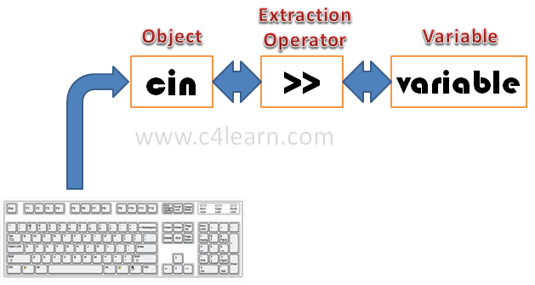
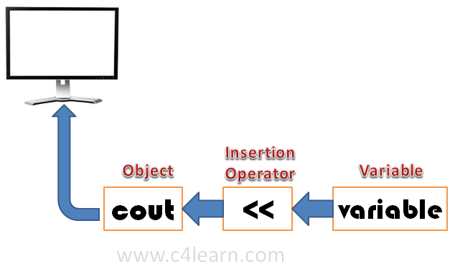
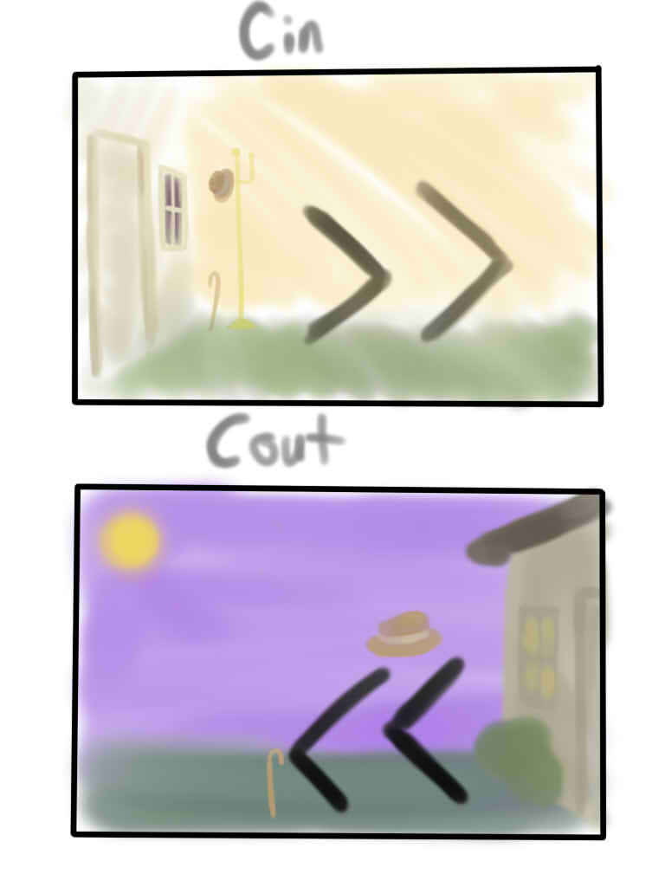
Unit 1: Concepts and Basics of C++ Programming
Bring in through cin and Take out through cout

Slide 37
Object ,Object and Object
A student, a professor
A desk, a chair, a classroom, a building
A university, a city, a country
A subjects such as Physics, Math, History, …

Slide 38





Daily Analysis
Look around you and identify some objects
Everything is an OBJECT

Slide 39
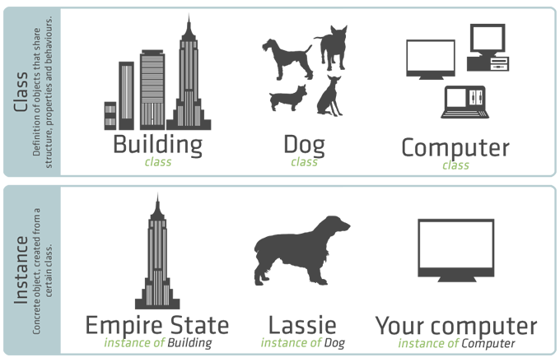
CLASSES v/s OBJECTS

Slide 40
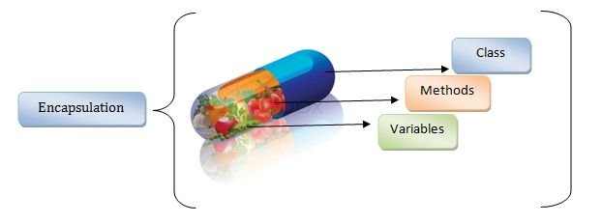
Encapsulation

Slide 41
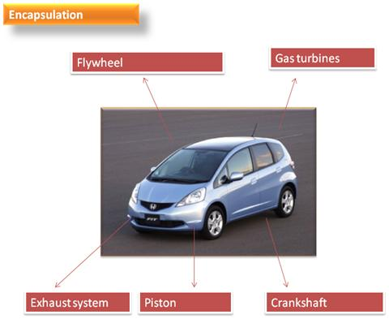
Encapsulation

Slide 42
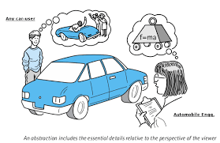
DATA ABSTRACTION

Slide 43
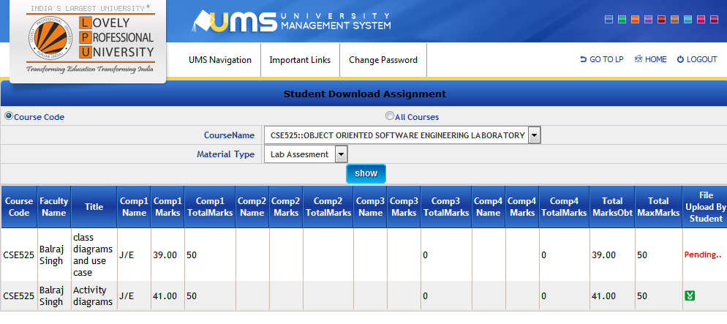
Hiding data
Update Marks

Slide 44
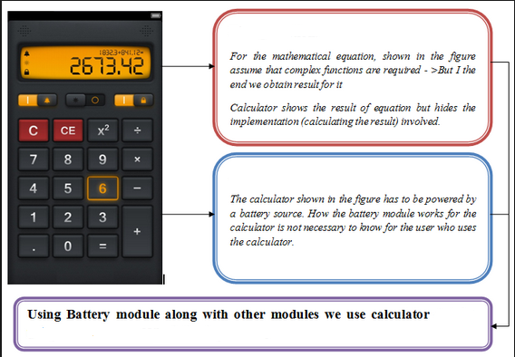
Hiding Details

Slide 45

Message Passing

Slide 46
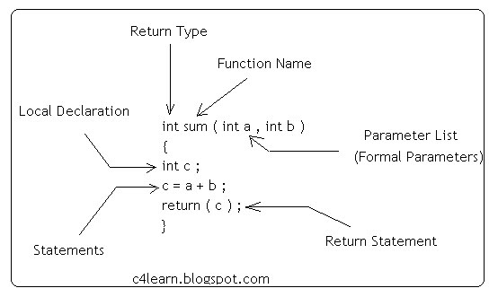
Unit I (Continued): Function

Slide 47
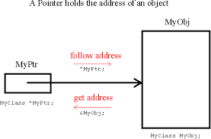
Unit II: Pointers, Arrays and String Concepts

Slide 48
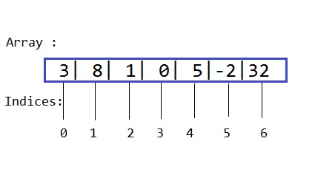
Array

Slide 49
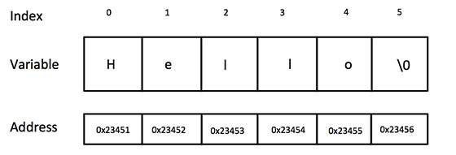
String

Slide 50
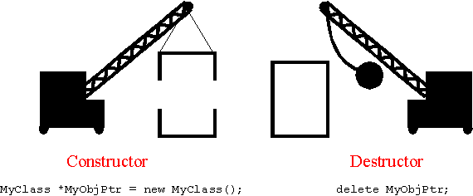
Unit III. Constructors, Destructors and File Handling

Slide 51
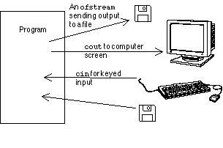
File Handling in C++

Slide 52
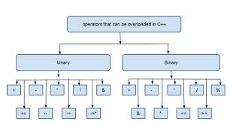
Unit IV. Operator Overloading and Type Conversion, Inheritance and Aggregation

Slide 53
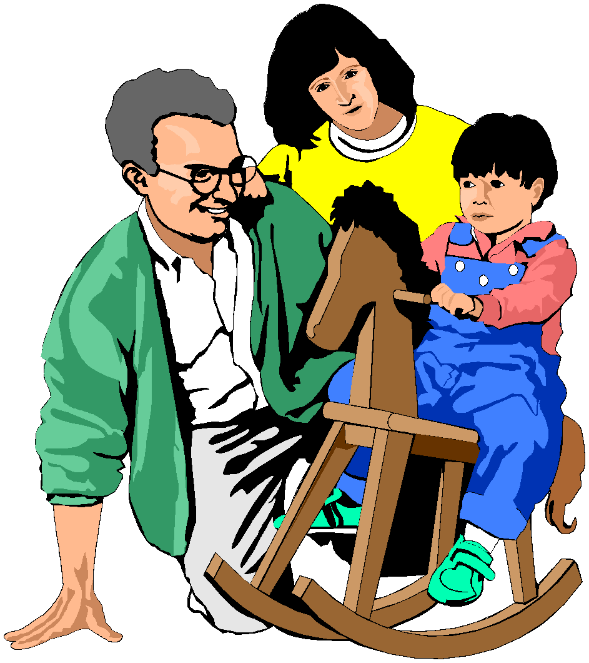
Traits Passed Through Inheritance
But Mummy, where did my blue eyes come from?

Slide 54

Student and Graduate Student

Slide 55
So what does this mean?
Student
Graduate Student
The Student Inherited and built upon the learning from past

Slide 56

Reuse, Reduce & Reliable !!!
Existing Features
Existing Features + Additional Features

Slide 57
Unit V: Dynamic Memory Management and Polymorphism
C++ uses new and delete operator for dynamic memory management.

Slide 58
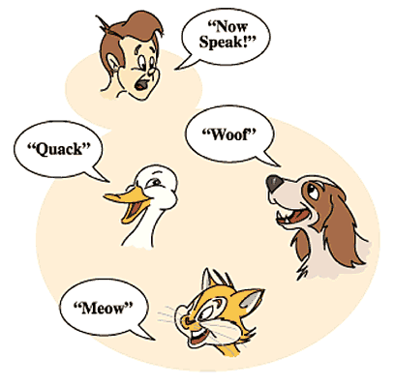
Polymorphism

Slide 59



Expression of a student
In front of father
In class
In CCD
One thing and many forms

Slide 60
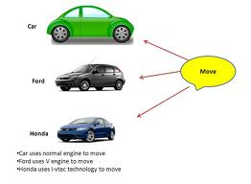
Example of Polymorphism

Slide 61
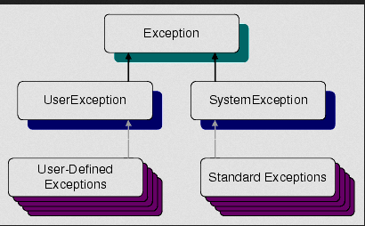
Unit VI: Exception Handling, Templates and Standard Template Library (STL)

Slide 62
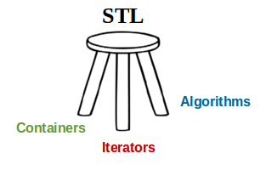
Standard Template Library

Slide 63
As an electronics and communication engineering student, why should I learn programming ?
Electronics and communication deals broadly with the following fields: 1. Analog Electronics 2. Digital Electronics 3. Communication 4. Digital signal processing 5. Miscellaneous( Control system etc.)
Notes:
Bioinformatics: the science of collecting and analysing complex biological data such as genetic
Biopython (a set of tools for bionformatics written using Python)
Evolutionary biology looks at the molecules of different organisms and determines whether they share a common evolutionary history.
Using bioinformatic techniques, scientists can test theories about how various proteins interact. These tests may help scientists understand how diseases develop in living organisms.
63

Slide 64
Apart from the first heading(Analog electronics) where programming is limited to spice tools and scripting for automation, all the other fields involve extensive programming.
Programming provides the means to implement the ideas for practical applications. i.e. : The digital circuits are implemented using verilog, whereas the signal processing algorithms are implemented on various platforms according to the application

Slide 65
Communication encompasses everything from antenna design to data communication. Except for the antenna and RF filters, every system is programmed chiefly by the electronics engineers.
Embedded systems are in use across all the application areas of electronics, the programming of which is a valuable skill for all electronics engineers.

Slide 66

Next Class: Concepts and Basics of C++ programming
Any Question?
Notes:
66

